Slide 1
Representing irregular aorist allomorph selection in Turkish
Utku Zobarlar and Adam McCollum
Rutgers University

Slide 2
Data
/-Aɾ/ selecting roots
 | Root-AOR | Gloss
a. | gyl-eɾ | ‘laughs’
b. | tut-aɾ | ‘holds’
Two basic allomorphs: /-Iɾ/, and /-Aɾ/
/-Aɾ/ attaches to uninflected monosyllabic verb roots.
/-Iɾ/ attaches to inflected or polysyllabic verb roots.
/-Iɾ/ selecting roots
 | Root-PASS-AOR | Gloss
a. | gyl-yn-yɾ | ‘be laughed’
b. | tut-ul-uɾ | ‘be held’
c. | ye-n-iɾ | ‘be eaten’
d. | de-n-iɾ | ‘be said’

Slide 3
Exceptional /-Iɾ/ SELECTING ROOTS
Final C |  | Root | Aorist | Gloss
/l/ | a. | al | al-ɯɾ | ‘take’
 | b. | bil | bil-iɾ | ‘know’
 | c. | bul | bul-uɾ | ‘find’
 | d. | gel | gel-iɾ | ‘come’
 | e. | kal | kal-ɯɾ | ‘stay’
 | f. | ol | ol-uɾ | ‘happen’
 | g. | øl | øl-yɾ | ‘die’
/ɾ/ | h. | duɾ | duɾ -uɾ | ‘stop’
 | i. | gøɾ | gøɾ-yɾ | ‘see’
 | j. | vaɾ | vaɾ-ɯɾ | ‘arrive’
 | k. | veɾ | veɾ-iɾ | ‘give’
 | l. | vuɾ | vuɾ-uɾ | ‘hit’
/n/ | m. | san | san-ɯɾ | ‘think’
13 verb roots select /-Iɾ/
All end in l, r or n.
These are highly frequent.

Slide 4
Some key questions
How is aorist irregularity in Turkish encoded in the grammar?
Phonologically?
Maybe without clear phonetic cues
Phonetically?
Or simply lexical?

Slide 5
Mora-based Account
Ito & Hankamer (1989) propose a mora-based prosodic analysis.
For them /-Ir/ is just /-r/
They propose a bimoraic minimal word condition
Liquids in irregular roots have an additional mora.
/-ɾ/ and epenthetic high vowel is attached
/bil_{μμ}+r/ → [bil-ir]_{μμ}
/sil_{μ} +Ar_{μ} / → [sil-er]_{μμ}

Slide 6
Moraicity and Duration
Phonetic duration is organized around the mora.
Direct manifestation of moraic structure in duration.
Monomoraic roots are the shortest, while trimoraic are the longest.
Phonemically long consonants reflect their moraic structure.
Beckman (1982), Broselow et al. (1997), Hubbard (1995), Cohn (2003), Port et al. (1987)

Slide 7
Predictions of Moraic Account
Regular liquid-final roots that select /-Ar/ are phonetically shorter
Exceptional (bimoraic) roots are phonetically longer

Slide 8
Frequency-Based account
Michon & Nakipoglu (2020) investigate whether rules or analogy plays a role in adults’ selection.
They find that a rule-based generalization favoring /-Ar/ is at work.
/-Ar/ use is highly frequent with monosyllabic nonce roots. (85%)
Their results indicate that irregularity is sensitive to type frequency.

Slide 9
Frequency and Duration
Frequent words have shorter acoustic durations.
More centralized vowel qualities due to frequent use.
High-frequency (HF) words tend to undergo reduction
Bybee et al. (2016), Kapatsinski et al. (2020), Tomaschek et al. (2013)

Slide 10
Predictions of frequency Account
Exceptional (/-Ir selecting) monosyllabic roots are shorter
Due to high type frequency
Their vowels are reduced and centralized

Slide 11
Two Competing Predictions
Two analyses predict conflicting outcomes:
Moraic account predicts longer duration of exceptional monosyllabic roots.
Usage-based account predict shorter duration and reduction of highly frequent exceptional roots.

Slide 12
possibilities
Mora-based account = longer duration
Frequency-based account = shorter duration, more centralization
Lexical specification = no phonetic manifestation, stored in the lexicon
Phonology with no clear phonetic manifestation

Slide 13
Experiment
Participants: 2 native Turkish speakers.
Stimuli:
12 exceptional roots (excluding san)
12 regular roots
Each was produced three times in its bare form and with the aorist suffix.

Slide 14
Experiment
Procedure:
Recordings done in a quiet room using Samsung Galaxy S8 mobile device.
Sampling frequency is 44,100Hz
Stimuli read from handouts

Slide 15
Experiment
Measurements:
Segment duration
Extracted F1 and F2 from vowel midpoint via a Praat script
Formant values were z-score normalized
|F1(z)| and |F2(z)| were used to calculate distance from center of the vowel space
Notes:
-models that included a random effect of speaker resulted in singularity (i.e., too few data for the more elaborated model); to remedy this, we z-score normalized spectral measurements to reduce interspeaker variation

Slide 16
experiment
Analysis:
We ran mixed-effect linear regression models using the lme4 package (Bates et al. 2013) in R (R Core team 2022).
For each model: Dependent variable ~ Regular + (1|Phoneme)

Slide 17
experiment
Statistical significance was assessed using model comparisons
Akaike Information Criterion (AIC) was used to evaluated model fit
Lower AIC is better
Difference in AIC > 8 supports superiority of one model over another

Slide 18
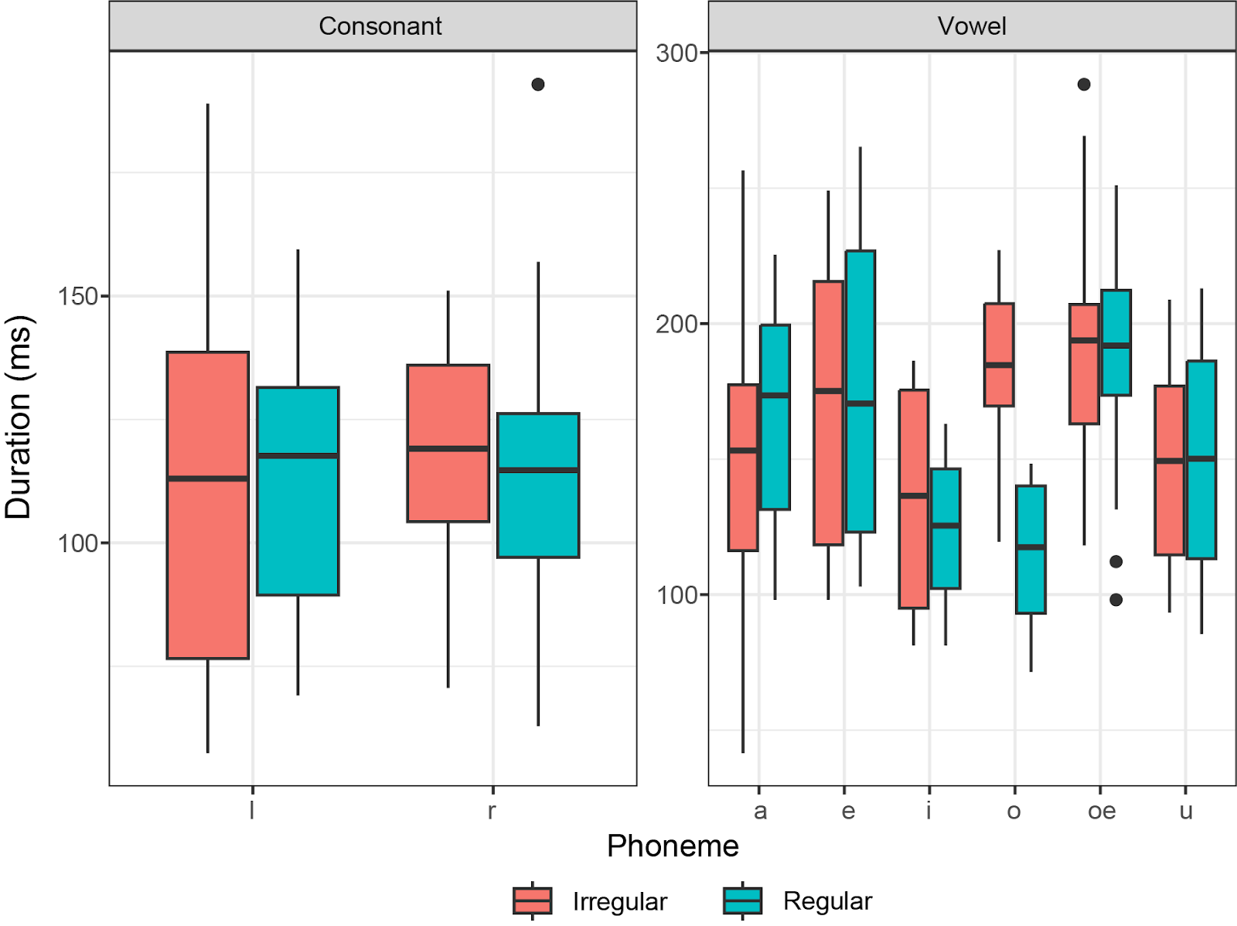
Results
Regularity was not a significant predictor of root-final consonant duration (p=.76) or vowel duration (p=.25)

Slide 19
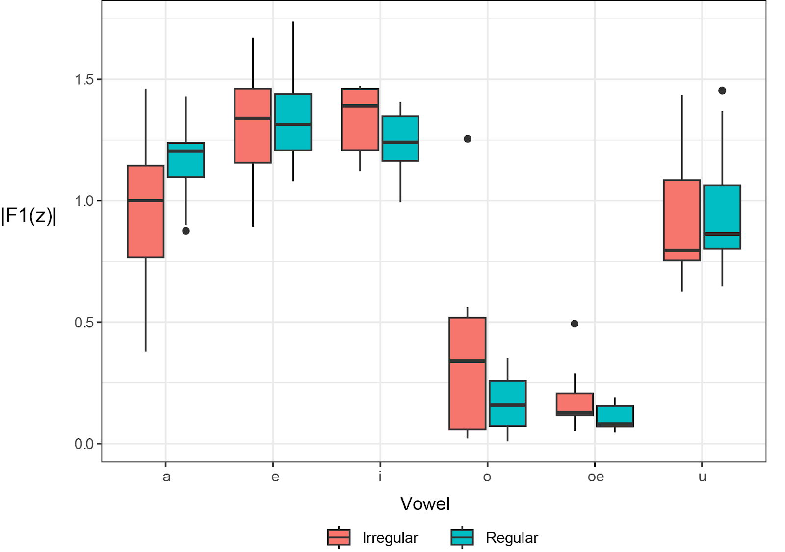
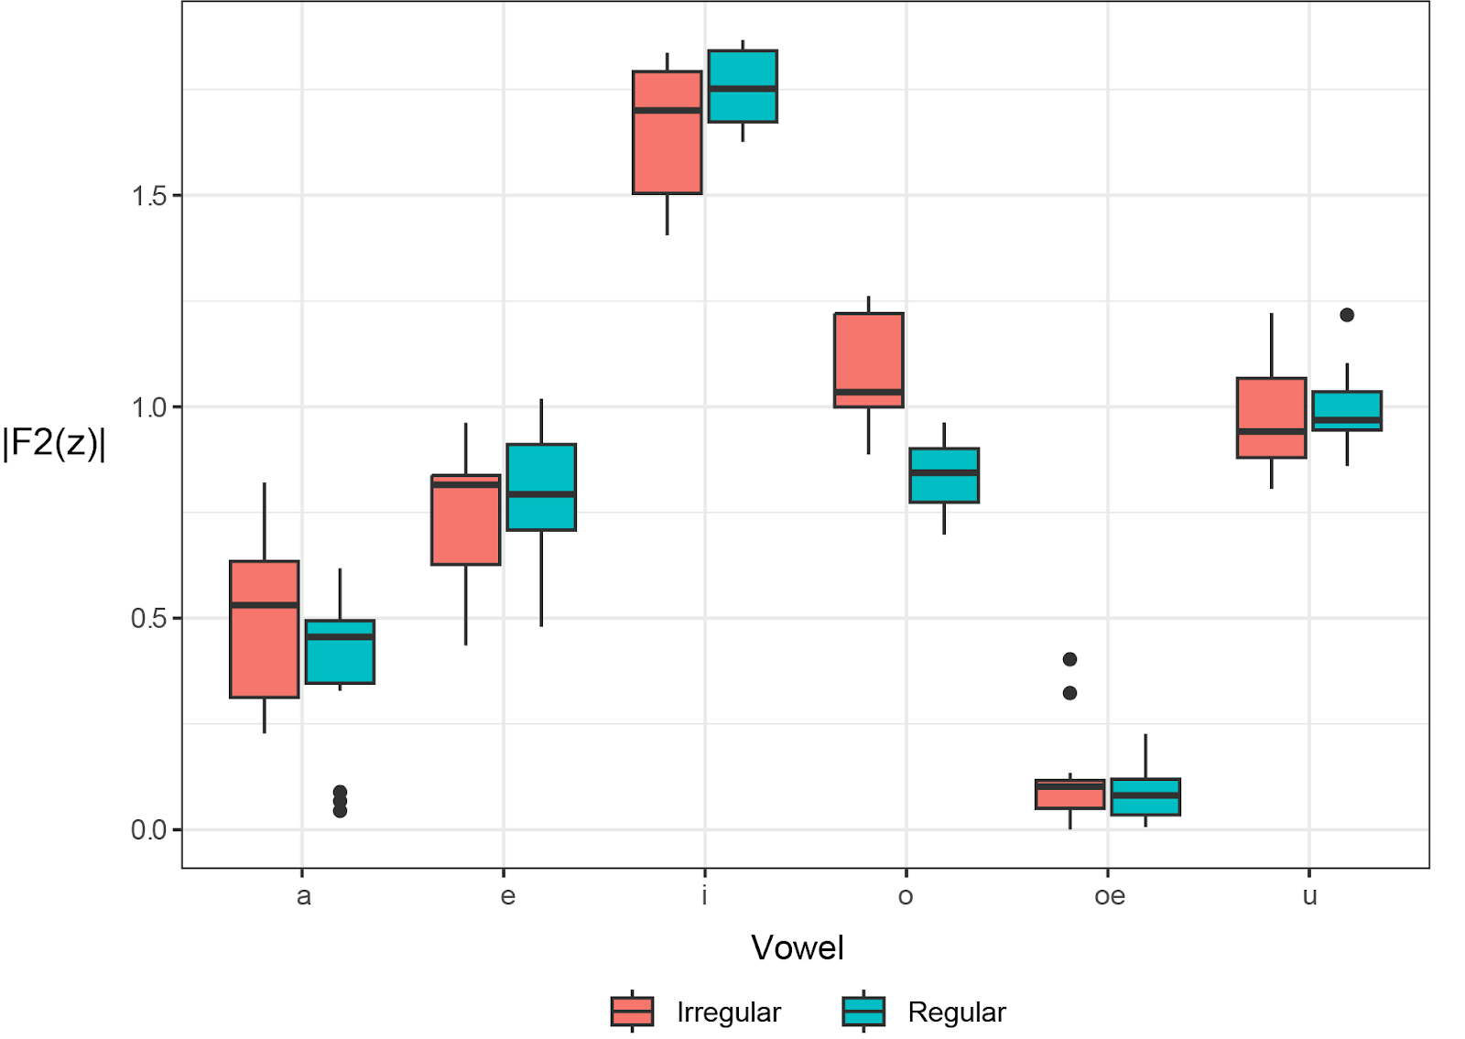
Results
Similarly, regularity was not a significant predictor of |F1| (p=.45) or |F2| (p =.15)

Slide 20
results
Though differences were not significant, AIC of every model that included regularity exhibited higher AIC than the alternatives.
This suggests that regularity actually hurt model fit.

Slide 21
RECAP
Two competing hypotheses predict contrasting outcomes
Moraicity account predicts longer duration of irregular roots
Usage-based account predicts vowel reduction and shorter duration of irregular roots

Slide 22
Discussion
No clear phonetic difference vowel duration
Durational difference between irregular and regular roots is not significant
No evidence of reduction
Vowels in irregular roots were not more centralized

Slide 23
FUTURE DIRECTIONS
Larger-scale experiment is needed:
More participants should be recruited
Data could be collected from a daily speech
Forms uttered in isolation are often unnatural

Slide 24
FUTURE DIRECTIONS
Issue at hand may not be phonetically realized
An abstract phonological mechanism may be conditioning the alternation
Are all phonological features phonetically realized?
What about other Turkic languages?
Other Oghuz languages (e.g., Turkmen, Azeri) do not have this alternation.

Slide 25
THANK YOU!

Slide 26
References
Beckman, M. E. (1982). Segment duration and the 'mora' in Japanese. Phonetica, 39(2-3), 113-135. https://doi.org/10.1159/000261655
Broselow, E., Chen, S.-I., & Huffman, M. (1997). Syllable weight: Convergence of phonology and phonetics. Phonology, 14, 47-83.
Bybee, J., Easterday, S., & Kapatsinski, V. (2020). Vowel reduction: A usage-based perspective. Rivista di Linguistica, 32(1), 19-42.
Bybee, J., File-Muriel, R. J., & Napoleão de Souza, R. (2016). Special reduction: A usage-based approach. Language and Cognition, 8(3), 421-446. https://doi.org/10.1017/langcog.2016.19
Cohn, A. (2003). Phonological structure and phonetic duration: The role of the mora. Working Papers of the Cornell Phonetics Laboratory, 15, 69-100.
Hubbard, K. (1995). Toward a theory of phonological and phonetic timing: Evidence from Bantu. In B. Connell & A. Arvaniti (Eds.), Phonological and Phonetic Evidence: Papers in Laboratory Phonology IV (pp. 168-187). Cambridge University Press.
Itô, J., & Hankamer, J. (1989). Notes on monosyllabism in Turkish. In J. Itô & J. Runner (Eds.), Phonology at Santa Cruz (Vol. 1, pp. 61-69). Syntax Research Center, University of California, Santa Cruz.
Nakipoğlu, M., & Michon, E. (2020). Abstraction vs. analogy in the Turkish Aorist. In Morphological Complexity within and across Boundaries: In Honour of Asli Göksel (Vol. 215, pp. 13-38).
Port, R., Dalby, J., & O’Dell, M. (1987). Evidence for mora timing in Japanese. The Journal of the Acoustical Society of America, 81, 1574-1585. https://doi.org/10.1121/1.394921
Tomaschek, F., Wieling, M., Arnold, D., & Baayen, R. H. (2013). Word frequency, vowel length and vowel quality in speech production: An EMA study of the importance of experience. In Interspeech (pp. 1302-1306). https://doi.org/10.21437/Interspeech.2013-2596

